Slide 1
Cascading Style Sheets
(CSS)
Walida Fayez
16.05.12
TU Belin

Slide 2
Outline
What is CSS?
  Definition
Levels of CSS
Syntax of CSS
Cascading Styling
CSS Box Model
Limitations
Advantages
References

Slide 3
What is CSS?
CSS stands for Cascading Style Sheets
Styles define how to display HTML elements
Styles were added to HTML to solve a problem
External Style Sheets can save a lot of work
External Style Sheets are stored in CSS files

Slide 4
Definition:
CSS is a style sheet language used for describing the presentation semantics (the look and formatting) of a document written in a markup language.
CSS was developed by the W3C.
The World Wide Web Consortium (W3C) is an international community where Member organizations, a full-time staff, and the public work together to develop Web standards.

Slide 5
Levels of CSS
1996 CSS 1
  Font
  Alignment
  Tables
May 1998 CSS 2
  Absolute
  Relative
  Positioning of elements
    Media type
      Aural style sheets
      Bidirectional text
      Font properties (shadows)
July 19, 2007 CSS 2.1
June 1999- November 2011

Slide 6
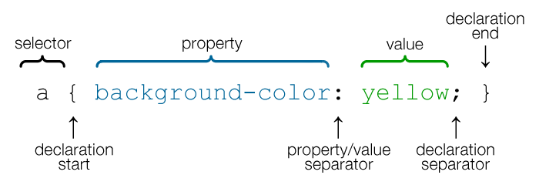
Syntax of CSS
Selector: the subject of the presentations
Property: is any characteristic of the selector that you wish to change like color, size etc.
Value: is what you wish the style to be
Figure 1

Slide 7
Cascading Styling
CSS properties used for background effects:
  background-color
  background-image
  background-repeat
  background-attachment
  Background-position

Slide 8
Styling Text
  Text Color
  Text Alignment
  Text Decoration
  Text Transformation
  Text Indentation
Styling Tables
Styling Fonts
Styling Links
Styling List

Slide 9
CSS Box Model
CSS Border
CSS Outline
CSS Margin
CSS Padding
Definition and Usage
The <div> tag defines a division or a section in an HTML document.
The <div> tag is used to group block-elements to format them with styles.

Slide 10
CSS Comments
used to explain the code
A CSS comment begins with "/*", and ends with "*/"
Example:
/*This is a comment*/
p
{
text-align:center;
/*This is another comment*/
color:black;
font-family:arial;
}

Slide 11
Limitations
Poor controls for flexible layouts
Selectors are unable to ascend
Vertical control limitations
Absence of expressions
Lack of column declaration
Cannot explicitly declare new scope independently of position
Pseudo-class dynamic behavior not controllable

Slide 12
Advantages:
Separation of content from presentation
Site-wide consistency
Bandwidth
Page reformatting
Accessibility

Slide 13
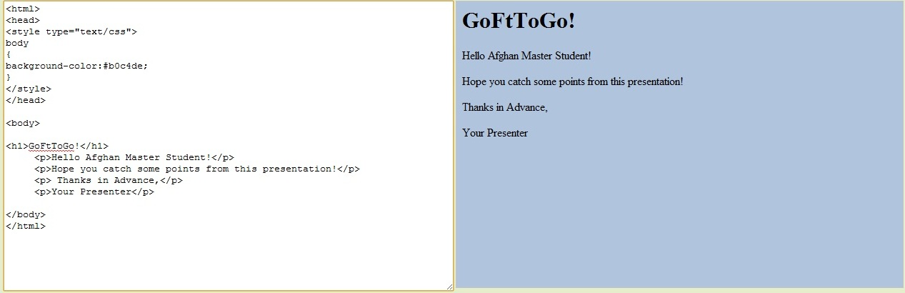
Example:

Slide 14
Thanks for your attention!

Slide 15
References
http://en.wikipedia.org/wiki/Cascading_Style_Sheets#Use
http://www.webopedia.com/TERM/C/CSS.html
http://www.w3schools.com
Figure:
http://www.google.de/imgres?q=cascading+style+sheets+selector,+value&start=367&hl=de&biw=1280&bih=596&gbv=2&tbm=isch&tbnid=15KK-3ucNm0RmM:&imgrefurl=http://en.support.wordpress.com/css-basics/&docid=vBwfsRSm7RBbGM&imgurl=http://en.support.files.wordpress.com/2011/09/css-selectors-lrg.png&w=700&h=240&ei=wjWuT4fyN4uPswa4gsi3Bg&zoom=1&iact=rc&dur=636&sig=113552613517023247845&page=16&tbnh=68&tbnw=197&ndsp=25&ved=1t:429,r:13,s:367,i:198&tx=105&ty=59

